Slide 2
Java JOptionPane
The JOptionPane class is used to provide standard dialog boxes such as message dialog box, confirm dialog box and input dialog box.
These dialog boxes are used to display information or get input from the user. The JOptionPane class inherits JComponent class.
A dialog is normally used as a temporary window to receive additional information from the user, or to provide notification that some event has occurred.
Java provides the JOptionPane class, which can be used to create standard dialogs. You can also build custom dialogs by extending the JDialog class.

Slide 3
Types of JOptionPanes
public static void showMessageDialog( Component parent, Object message) Displays a message on a dialog with an OK button.
public static int showConfirmDialog( Component parent, Object message) Displays a message and list of choices Yes, No, Cancel.
public static String showInputDialog( Component parent, Object message) Displays a message and text field for input, and returns the value entered as a String.

Slide 4
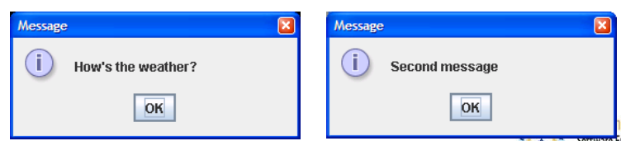
JOptionPane examples 1
import javax.swing.*;
class MessageDialogExample {
public static void main(String[] args) {
JOptionPane.showMessageDialog(null,
"How's the weather?");
JOptionPane.showMessageDialog(null,
"Second message");
}
}

Slide 5
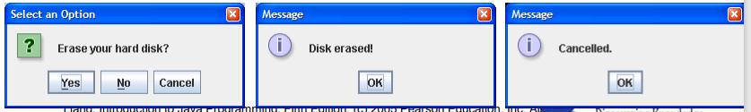
JOptionPane examples 2
import javax.swing.*;
class ConfirmDialogExample {
public static void main(String[] args) {
int choice = JOptionPane.showConfirmDialog(null,
"Erase your hard disk?");
if (choice == JOptionPane.YES_OPTION) {
JOptionPane.showMessageDialog(null, "Disk erased!");
} else {
JOptionPane.showMessageDialog(null, "Cancelled.");
}
}
}

Slide 6
JOptionPane examples 3
import javax.swing.*;
class InputDialogExample {
public static void main(String[] args) {
String name = JOptionPane.showInputDialog(null,
"What’s your name?");
JOptionPane.showMessageDialog(null, “Hello " + name);
}
}

Slide 7
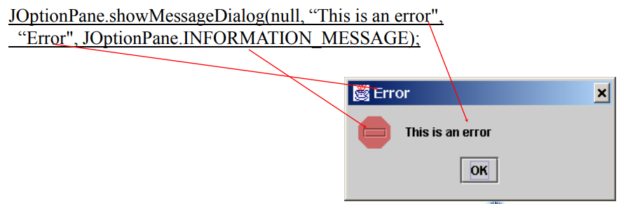
Message Dialogs
A message dialog box simply displays a message to alert the user and waits for the user to click the OK button to close the dialog.

Slide 8
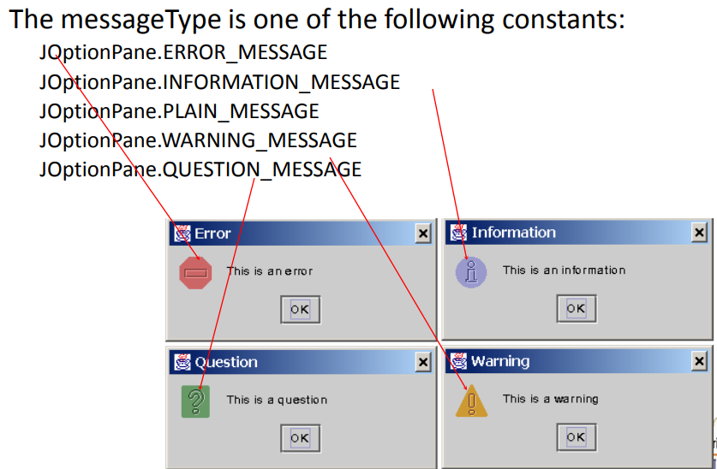
Message Types

Slide 9
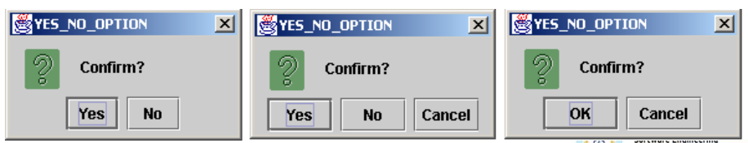
Confirmation Dialogs
A message dialog box displays a message and waits for the user to click the OK button to dismiss the dialog. The message dialog does not return any value. A confirmation dialog asks a question and requires the user to respond with an appropriate button. The confirmation dialog returns a value that corresponds to a selected button.

Slide 10
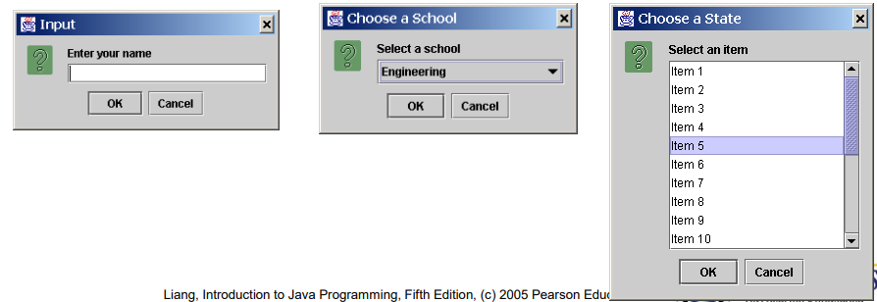
Input Dialogs
An input dialog box is used to receive input from the user. The input can be entered from a text field or selected from a combo box or a list. Selectable values can be specified in an array, and a particular value can be designated as the initial selected value.

Slide 11
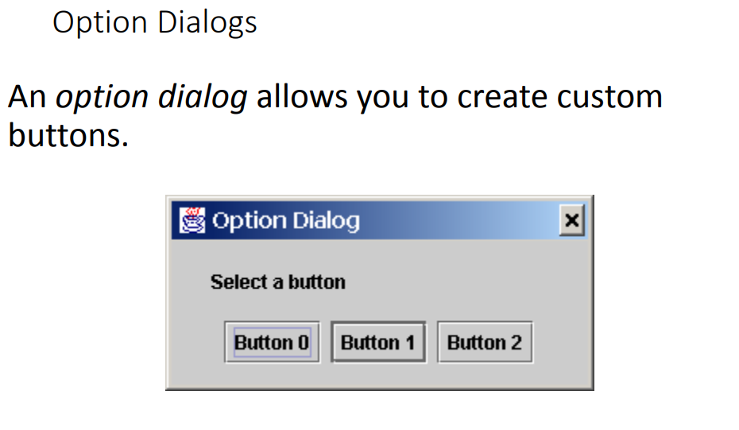

Slide 12
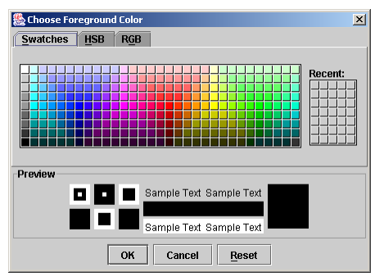
JColorChooser
Color dialogs are commonly used in GUI programming. Swing provides a convenient and versatile color dialog named javax.swing.JColorChooser. Like JOptionPane, JColorChooser is a lightweight component inherited from JComponent. It can be added to any container

Slide 13
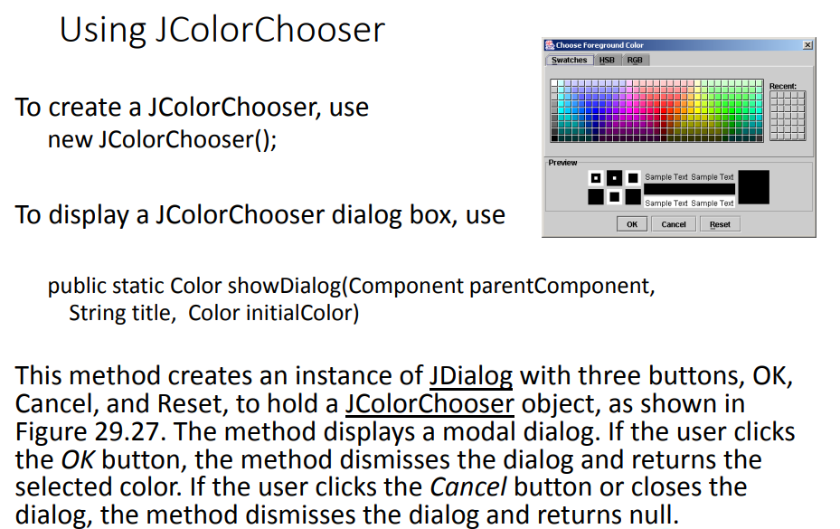

Slide 14
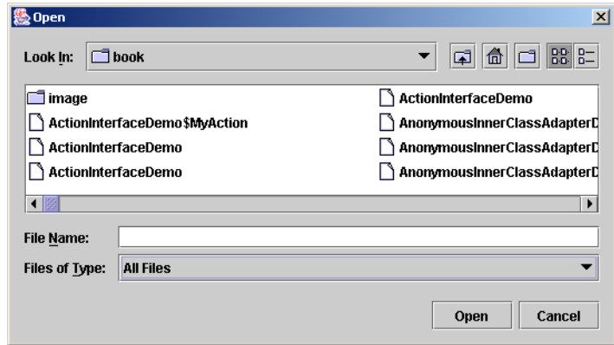
JFileChooser
Swing provides the javax.swing.JFileChooser class that displays a dialog box from which the user can navigate through the file system and select files for loading or saving

Slide 15
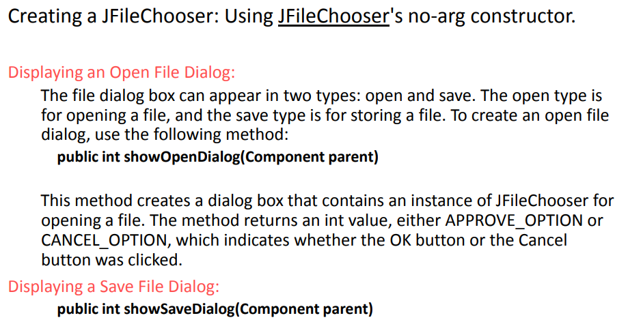
Using JFileChooser

Slide 16
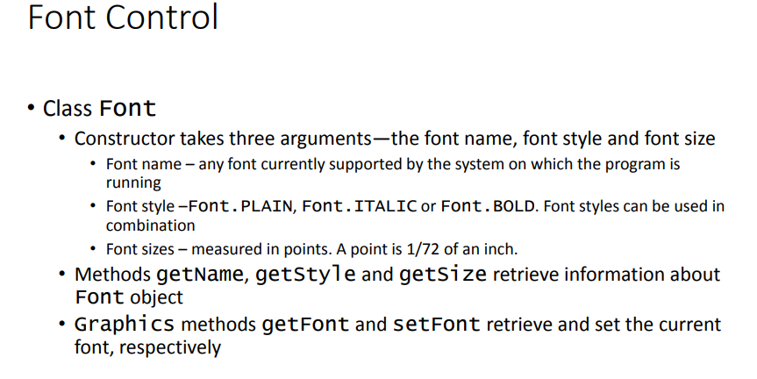

Slide 17
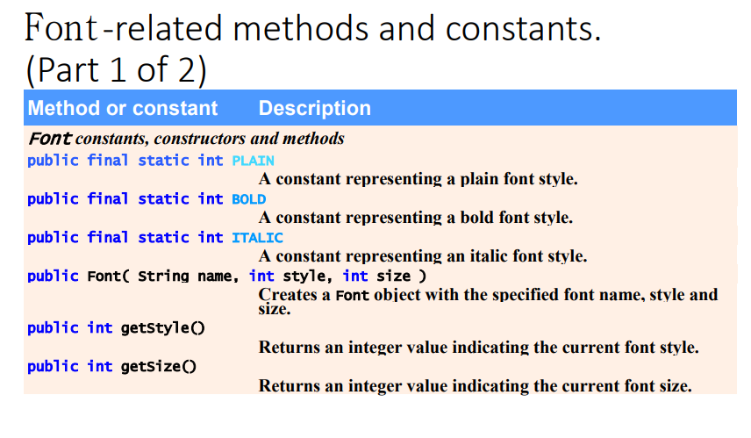

Slide 18
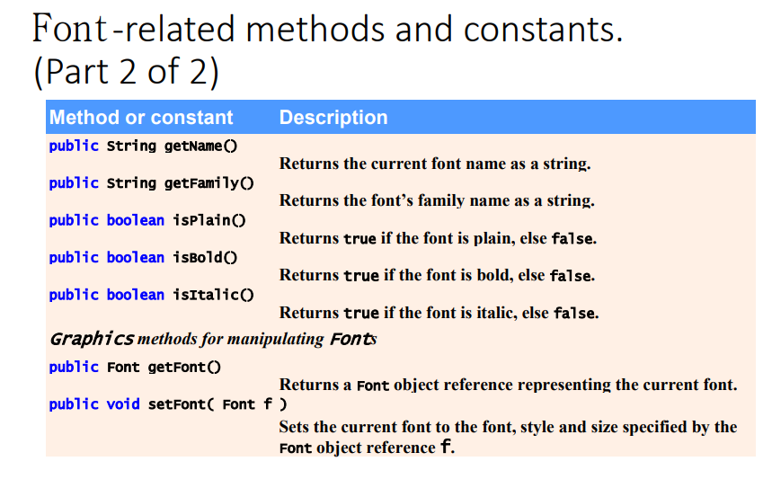

Slide 19
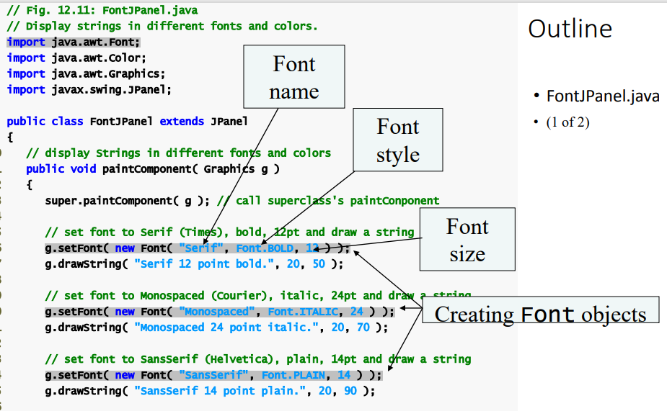

Slide 20
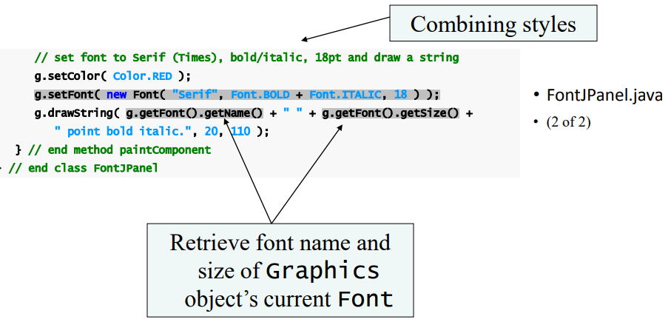

Slide 21
